Slide 1
Infill Development Incentive Program
Analysis
Economic Development

Slide 2
Where are we looking for infill information?

Slide 3
Master Agreements Document & El Paso Central Appraisal District
The dataset comprises of historical infill agreements & property valuations.
Maintained by Compliance & EPCAD

Slide 4
How much infill incentives has the city disbursed?

Slide 5
Total Infill Incentives Paid Out
The cumulative total of incentives disbursed to date
Sum of incentives: $171,474.97

Slide 6
What is the overall status of the infill program?

Slide 7

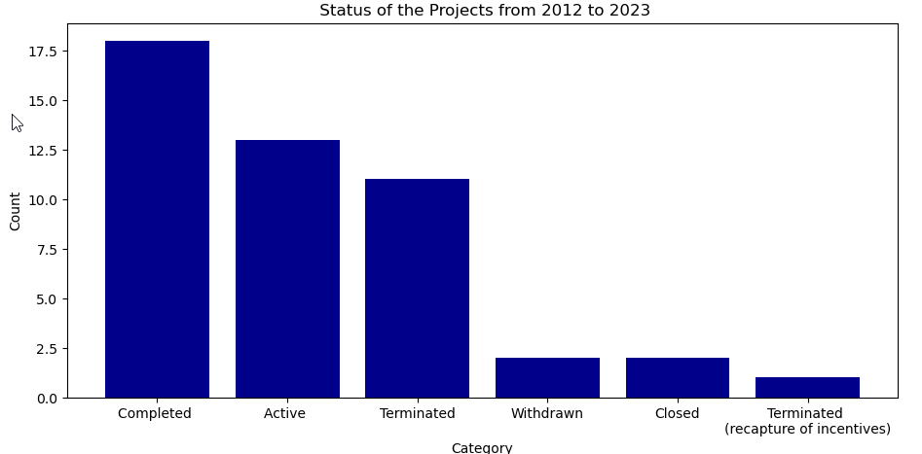
Infill Project Status
Completed | 18
Active | 13
Terminated | 11
Withdrawn | 2
Closed | 2
Terminated (recapture of incentives) | 1

Slide 8
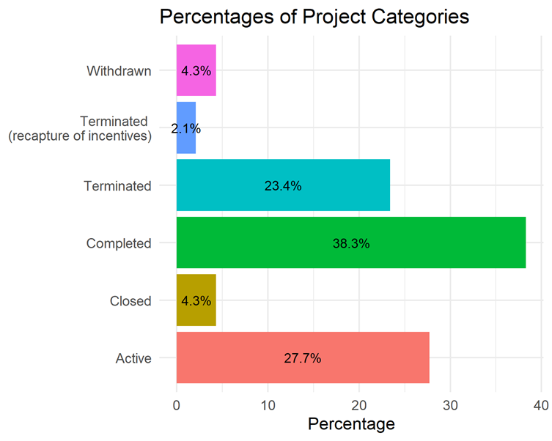
Infill Project Status
Success Rate of the infill Program: 55%

Slide 9
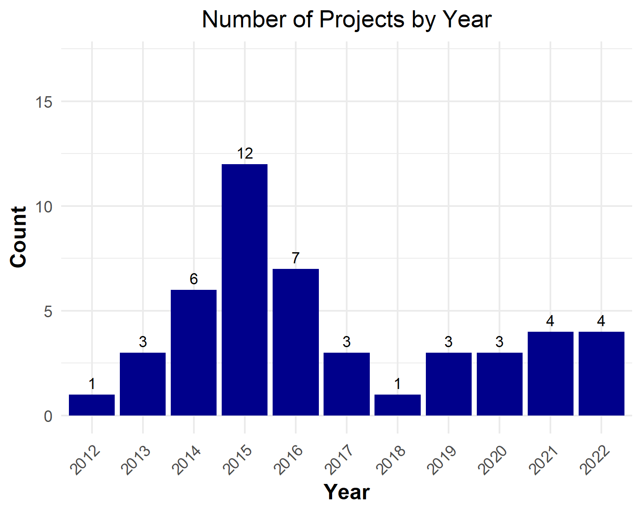
Infill Projects By Year
Success Rate of the Infill Program 52.94117647058824 %

Slide 10
How many projects can we expect in the upcoming years?

Slide 11
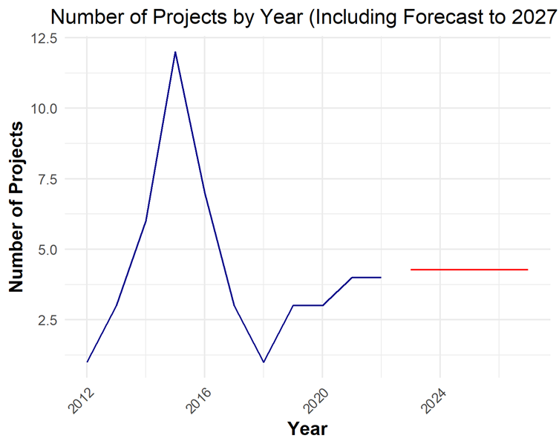
Infill Forecast to 2027
Predicted Possible Projects to 2027

Slide 12
What industries make up the infill program?

Slide 13
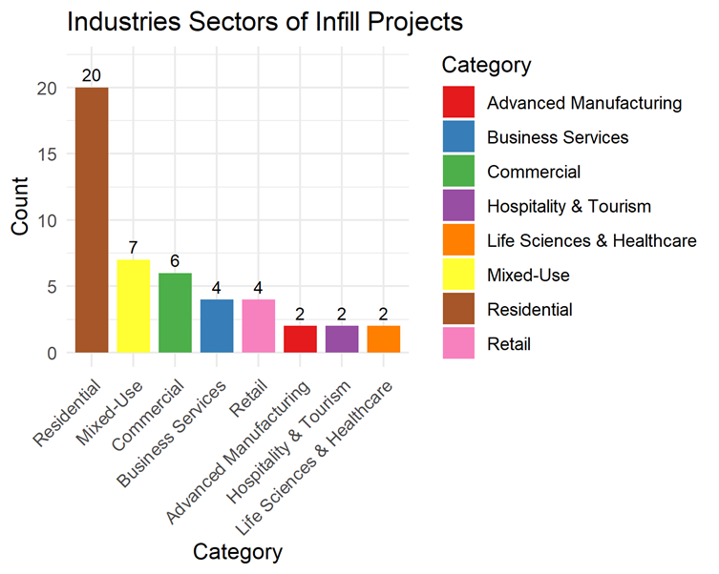
Industry sectors

Slide 14
What is the benefit of the infill program?

Slide 15
City Benefits
The total city benefits for Infill completed projects at 25 years:
$5,866,687
Average city benefit for a completed project at 25 years:
$451,283.6

Slide 16
Today is 2025?

Slide 17
Infill Projects
Infill Projects for 2023 = 0
Infill Projects for 2024 = 4
Infill Projects for 2023 = 1

